Slide 1
Hi there facilitator,
These slides and notes (see notes pages) are a resource.
You decide if and how you can best use them
Use as many or as few as you want
Use none if you’d prefer

Slide 2
The Resilience Game

Slide 3
Introductions
Who
What
One thing . . .
Notes:
If players don’t already know each other, Invite them to briefly share their name, role description and 1 thing that has been on their mind so far today
You role model by going first
If players do already know each other it is still best-practice to get them speaking and engaging at this early stage. A suggestion would be to ask each player to share a word or brief phrase on what resilience means to them

Slide 4
Housekeeping
Toilets
Breaks
Timings
Fire alarm
Smoking
Mobile devices
Expected finish
Notes:
Run through the specific domestics that apply to your session (amend slide accordingly)

Slide 5
Session overview
Resilience introduction (3 mins)
The Resilience Game introduction (2 mins)
Game play (70 mins)
Debrief and discussion (10 mins)
Commitment to action (5 mins)
Notes:
(These agenda items and timings shown here are purely a guide. Amend to suit your session.
The “Commitment to action” section is the way to get a public commitment from everyone to at least one specific action.)
Briefly run through the Session Overview of the session with participants:
Resilience: Key traits of resilience, Why develop our resilience, Benefits of a resilient workforce
Building Resilience Game introduction: learning outcomes, playing the game, using the cards, using the action planner, the facilitator role
Debrief and discussion: update planner, debrief discussion, answers to fact or fiction cards, , consolidate learning, discuss responses to other cards
Commitment to action: All players make a public commitment to at least one specific action

Slide 6
Resilience
1
Notes:
Explain that you will begin with a short session on what Resilience is, to set the scene.

Slide 7


What is resilience?
The Reed and the Oak Tree fable
What does resilience mean to you?
Notes:
Invite a player to read the Reed and the Oak Tree fable. (it’s on the back of each instructions card)
Ask players for their reflections on the Reed and the Oak Tree, specifically in relation to what resilience is.
Ask players what resilience means to them.

Slide 8
Resilience is…
An individual’s ability to successfully cope with adversity
The capacity to recover quickly from difficulties; toughness
The ability of a substance of object to spring back into shape; elasticity
A person’s ability to deal with stress and bounce back from adversity – without permanent damage or distortion
Relies on different skills we can all build – we can all learn techniques to build our resilience
Notes:
Share these definitions:
Experts have defined resilience as an attitude that empowers people to examine, boost and use the strengths, characteristics, and other resources available to them. Definitions include:
An individual’s ability to successfully cope with adversity (Wikipedia)
The capacity to recover quickly from difficulties; toughness (Oxford English Dictionary)
The ability of a substance of object to spring back into shape; elasticity (Oxford English Dictionary)
A person’s ability to deal with stress and bounce back from adversity – without permanent damage or distortion (Mark McGuinness, author of “Resilience”)
We are all capable of becoming a more “resilient person”. Resilience is innate within. It’s logical therefore that we can learn techniques to build our resilience.

Slide 9
Key traits of resilience
Awareness
Notes:
Before revealing the key traits of resilience on the next slide, ask players for 2-3 examples.
You have “Awareness” already on the slide to start people off

Slide 10
Key traits of resilience
Awareness
Adaptability
Responsibility
Problem-solving
Empathy
Optimism
Humour
Notes:
Explain:
The key traits of those who have built resilience include:
Awareness
Adaptability
Responsibility
Problem-solving
Empathy
Optimism
Humour.

Slide 11
Why develop our resilience?
Notes:
Before revealing the next slide, ask the players for their thoughts on this and invite some examples.
If time permits, flipchart or screen share their suggestions.

Slide 12
Why develop our resilience?
Fast-paced working world
Recover quickly from mistakes
Focus on thoughts and feelings
Observe own actions and responses
Practical ideas on how to make positive changes
Notes:
Explain:
Today’s working world is fast-paced and often filled with change, confusion and uncertainties. Everyone needs support to develop their resilience in the face of the changing nature of work. Resilience allows us to recover quickly from perceived “failures” and mistakes and to learn from these.
Developing our resilience requires us to focus on our thoughts and feelings and observe their actions and responses. Developing resilience helps people see things in different ways and get practical ideas on how to make positive changes.

Slide 13
How will our organisation benefit from a resilient workforce?
Notes:
Before revealing the next slide, ask players for their thoughts on this and invite some examples.
If it is important to your context, flipchart or screen share their suggestions.

Slide 14

How will our organisation benefit from a resilient workforce?
Positive approach to change
Increased efficiency and productivity
A more proactive workforce
Reduced workplace conflict
Notes:
Explain:
The main organisational benefits of a resilient workforce include:
A more flexible, creative and positive approach to change
Increased efficiency and productivity, through individuals managing their workload and other commitments better
A more proactive workforce – people are able to move towards change with a positive mind-set and can-do attitude
Reduced workplace conflict as people are more able to remain calm under pressure.

Slide 15
The Resilience Game introduction
2

Slide 16
About the game
Builds skills and knowledge
Celebrates your current resilience capability and increases it
Unlike traditional board games, this one is all about the discussions
Provides you with the opportunity to link this important subject directly to your own work-based reality
Notes:
Explain that the Resilience Game is a learning device, suitable for all experience levels which:
Builds skills and knowledge in people, teams and organizations'
Celebrates your current resilience capability and increases it as you create actions to apply straight away.
Unlike traditional board games, this one is all about the discussion. Some players may have to suppress their ‘winner gene’.
Provides you with the opportunity to link this important subject directly to your own work-based reality.

Slide 17
Learning outcomes
On completion of the game and debrief, players will be able to:
Describe resilience for the individual and organisation
State at least five resilience qualities they recognise in themselves
Recall at least four situations where they have been resilient in their professional and personal lives.
Describe three ways to help colleagues appreciate their own resilience.
Plan a minimum of three specific actions to develop their resilience. People managers will also have actions to help and support their people in building their resilience
Action plan to overcome at least two personal resilience challenges.
Notes:
Explain the learning outcomes participants will gain from the session:
Add: If you are a Manager, you will also have actions around how you can help and support your people in building their resilience too.

Slide 18
Game play
Make sure you have an action planner
Read the instructions before starting
Record your learnings and actions as you play
Play begins on the start square
Use the 3-minute timer as a guide only
Notes:
(Provide the following guidance to players on getting started:
The game is designed as “click and play”. Simply click the player disc and start playing, looking at the instructions as you play.
Some teams will have a need to read the instructions first. That’s ok too.)
Have your Action planners at the ready as you are expected to record your learning and actions in the action planner as gameplay unfolds
All players have their chosen playing pieces on the start square, taking it in turns to click their disc on the left hand side of the screen they move round the board following the direction of the arrows
The 3-minute timer is there to click before each turn. It’s a guide not a straight jacket. Many facilitators don’t use it. The objective is to have all players get as many opportunities as possible

Slide 19
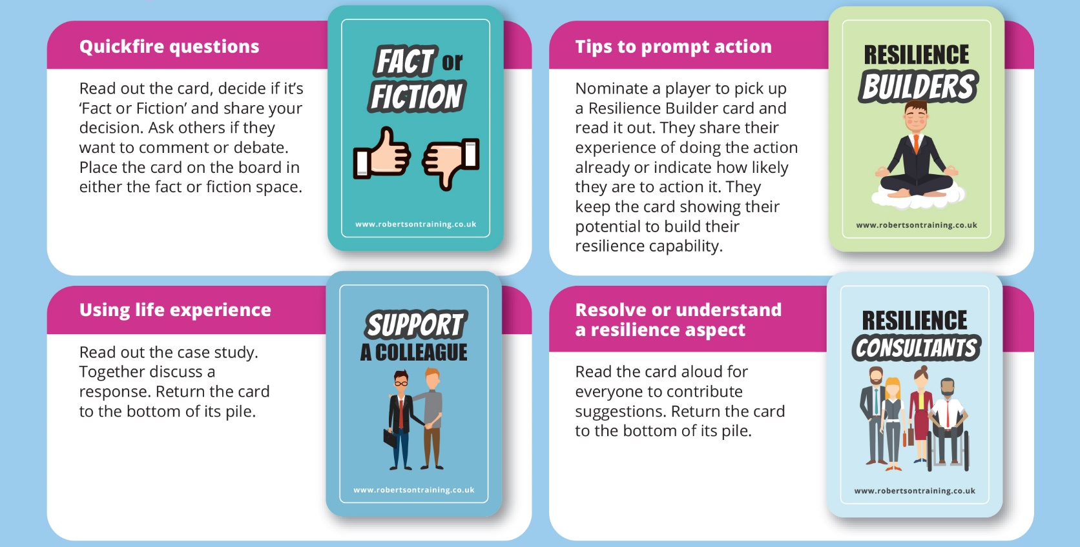
The cards
Fact or fiction – Quick-fire questions
Resilience builders – Tips to prompt action
Support a colleague – Using life experience
Resilience consultants – Resolve or understand a resilience aspect
Pause and reflect squares – Bringing your resilience capabilities to the surface
Notes:
If you feel you need to – give a brief explanation of the card categories:
Fact or fiction - Quickfire questions. Read out the card, decide if it’s ‘Fact or fiction’ and share your decision. Ask others if they want to comment or debate.
Resilience builders - Tips to prompt action. Nominate a player to read out the Resilience Builder card. They share their experience of doing the action already or indicate how likely they are to action it. They keep the card by adding it to their bank.
Support a colleague - Using life experience. Read out the case study. Together discuss a response.
Resilience consultants - Resolve or understand a resilience aspect. Read the card aloud for everyone to contribute suggestions.
Pause and reflect - Bringing your resilience capabilities to the surface. Think about a time when you needed to be resilient. On your next turn, share what specifically you did to be resilient through it. Remember, it’s up to you what and how much you share. Play then passes to the next person.
On squares with the Stop and Action Plan image - Once the player’s turn ﬁnishes, everyone takes one minute to update their action planner with learnings, insights, personal notes and actions. Play restarts after the minute.
3-minute timer - It’s easy to go down a rabbit hole of discussion. We’ve included a 3-minute timer to help you stay relaxed yet conscious of time. It’s up to you whether or not you use it.

Slide 20
Using your Action Planner
A positive help to you
Record your learning and actions in the action planner as the game unfolds
During stop and action time outs
The page for three actions is very important
Notes:
Explain the purpose of the Action planner and how it should be used during the game:
- It is a positive help to players
- It’s up to them what they put in its spaces
- Encourage scribbling throughout their game time (they can for example record their decisions about Fact or Fiction)
The game board includes ‘Stop & Action Plan’ time outs to capture notes and actions (Once the player who lands here finishes their turn, everyone takes one minute to update their action planner with learnings, insights, personal notes and actions. Play restarts after the minute.)
All players should have completed their 3 actions in the “My Action Plan” section by the end of the session

Slide 21
The facilitator role
Support you
On hand for questions
Help everyone keep to time
Facilitate a debrief after play
Make sure you leave with specific actions
Follow-up with you afterwards
Notes:
Explain to players that your role, as facilitator, is to:
Support you in making best use of your time
Answer your questions, help and to support you as needed throughout play
Offer clarity needed and keep the game moving
Facilitate a debrief discussion during which you will consolidate your key learnings and share actions
Make sure you leave with specific actions
Follow-up with you afterwards – to keep up momentum for actions and results

Slide 22

Questions?
During gameplay
Notes:
Let players know that you may ask some questions to:
Tease out learning
Compare a card’s content to our team
Bring out resilient capabilities, mindsets and behaviours players already have
Examples of open questions are:
And what did you learn from that?
How might that card connect to our team?
With that experience what did you do to be resilient?

Slide 23
Game play
3

Slide 24
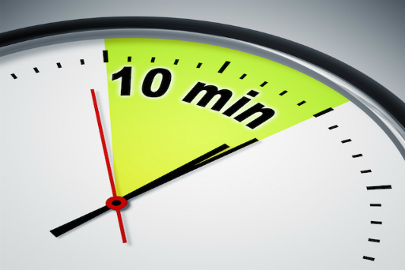
Gameplay
Notes:
Best to let players know when there are ten-minutes to go.
You can assess the appetite to play beyond the 70-minutes game time. If there is value keep playing.

Slide 25
Debrief
4

Slide 26
Action Planner
Update your Action Planner
Notes:
Ask players to make any final updates to their Action Planner.
Allow a couple of minutes for this, giving you time to catch a breath.
If time allows, this is a good opportunity to offer players a quick comfort break.

Slide 27

How did you get on?
Notes:
Ask some general questions to get some sharing.
Examples of wide open questions are:
How did you find it?
What did you notice playing the game?

Slide 28
Fact or fiction cards
Fact | Fiction
1
 | 2
3
 | 4
5
6
7
8
9
 | 10
11
12
Notes:
If required confirm the answers to the Fact or Fiction cards.

Slide 29
Discussion
What was your best discussion?
What did you learn from someone else in your group?
What surprised you?
What reassured you?
What was your most helpful learning?
What other thoughts, observations or questions?
Notes:
Facilitate a discussion to consolidate learning.
The following questions are examples for you.
What did you learn from someone else in your group?
What surprised you?
What reassured you?
What was your most helpful learning?
Any other thoughts or questions?
Players might also want to discuss their responses to some of the Resilience Builders, Support a Colleague or Resilience Consultants cards. It’s ok that players might disagree about a card’s content, its purpose or a solution to its question.

Slide 30
Learning outcomes
On completion of the game and debrief, players will be able to:
Describe resilience for the individual and organisation
State at least five resilience qualities they recognise in themselves
Recall at least four situations where they have been resilient in their professional and personal lives.
Describe three ways to help colleagues appreciate their own resilience.
Plan a minimum of three specific actions to develop their resilience. People managers will also have actions to help and support their people in building their resilience
Action plan to overcome at least two personal resilience challenges.
Notes:
Remind people of the Learning outcomes
Ask them to what extent they have been achieved.

Slide 31
Commitments
5

Slide 32

Commitments
One specific action
Notes:
Remind players that the true value of the game comes from implementing actions and seeing results.
Conclude by seeking a public commitment from everyone to at least one action.
One way to do this is to:
Invite one person to share one action
When they finish, ask them to choose the next person
Repeat this until everyone has shared
Another option is to have everyone write one action on a sheet of paper, then share them.
Your role as facilitator is to make sure people’s actions are specific. Ask people to give more detail if their action is vague such as “to be more resilient” or “to communicate better.”

Slide 33
Thank you
Notes:
Thank players for their time and input.
Encourage them to complete their actions and notice their results.
Let them know what follow-up you will be doing.
Check for outstanding questions.
Players complete evaluation forms (if applicable).

Slide 34

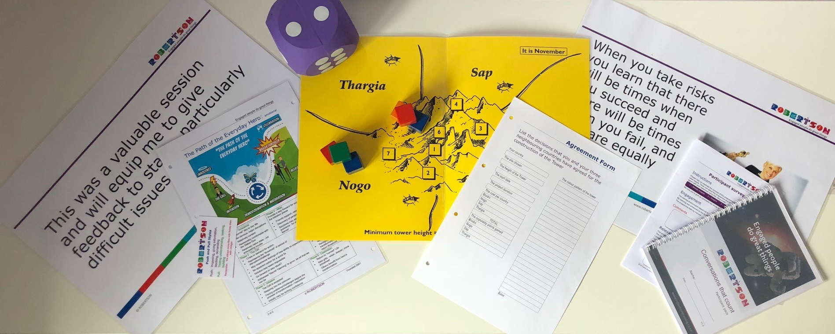
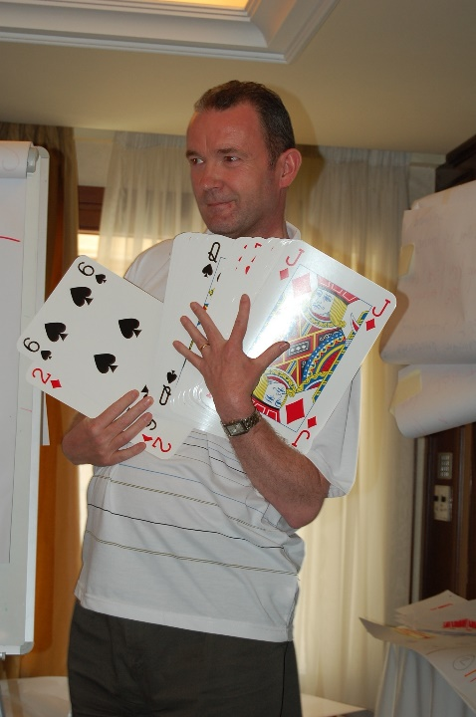
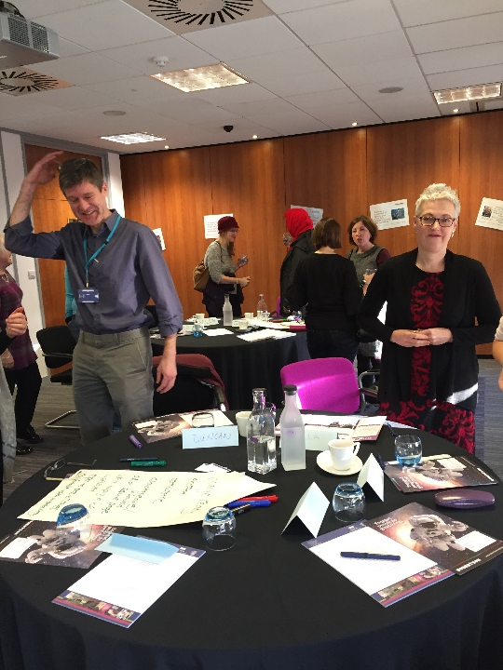
Learning is created not consumed
Business skills, leadership and management development, team development and more

Slide 35
www.robertsontraining.co.uk
Tel: 01786 447 548
Email: Elaine@robertsontraining.co.uk
Business skills, leadership and management development, team development and more

