Slide 1
Hi there,
These slides and notes (see notes pages) are a resource.
You decide if and how you can best use them
Use as many or as few as you want
Use none if you’d prefer

Slide 2
Debrief

Slide 3
Action Planner
Update your Action Planner
Notes:
Ask players to make any final updates to their Action Planner.
Allow a couple of minutes for this, giving you time to catch a breath.
If time allows, this is a good opportunity to offer players a quick comfort break.

Slide 4
How did you get on?
Notes:
Ask some general questions to get some sharing.
Examples of wide open questions are:
How did you find it?
What did you notice playing the game?

Slide 5
Fact or fiction cards
Fact | Fiction
1
 | 2
3
 | 4
5
6
7
8
9
 | 10
11
12
Notes:
If required confirm the answers to the Fact or Fiction cards.

Slide 6
Discussion
What was your best discussion?
What did you learn from someone else in your group?
What surprised you?
What reassured you?
What was your most helpful learning?
What other thoughts, observations or questions?
Notes:
Facilitate a discussion to consolidate learning.
The following questions are examples for you.
What did you learn from someone else in your group?
What surprised you?
What reassured you?
What was your most helpful learning?
Any other thoughts or questions?
Players might also want to discuss their responses to some of the Resilience Builders, Support a Colleague or Resilience Consultants cards. It’s ok that players might disagree about a card’s content, its purpose or a solution to its question.

Slide 7
Learning outcomes
On completion of the game and debrief, players will be able to:
Describe resilience for the individual and organisation
State at least five resilience qualities they recognise in themselves
Recall at least four situations where they have been resilient in their professional and personal lives.
Describe three ways to help colleagues appreciate their own resilience.
Plan a minimum of three specific actions to develop their resilience. People managers will also have actions to help and support their people in building their resilience
Action plan to overcome at least two personal resilience challenges.
Notes:
Remind people of the Learning outcomes
Ask them to what extent they have been achieved.

Slide 8
Commitments
5

Slide 9
Commitments
One specific action
Notes:
Remind players that the true value of the game comes from implementing actions and seeing results.
Conclude by seeking a public commitment from everyone to at least one action.
One way to do this is to:
Invite one person to share one action
When they finish, ask them to choose the next person
Repeat this until everyone has shared
Another option is to have everyone write one action on a sheet of paper, then share them.
Your role as game host is to make sure people’s actions are specific. Ask people to give more detail if their action is vague such as “to be more resilient” or “to communicate better.”

Slide 10
Thank you
Notes:
Thank players for their time and input.
Encourage them to complete their actions and notice their results.
Let them know what follow-up you will be doing.
Check for outstanding questions.
Players complete evaluation forms (if applicable).

Slide 11
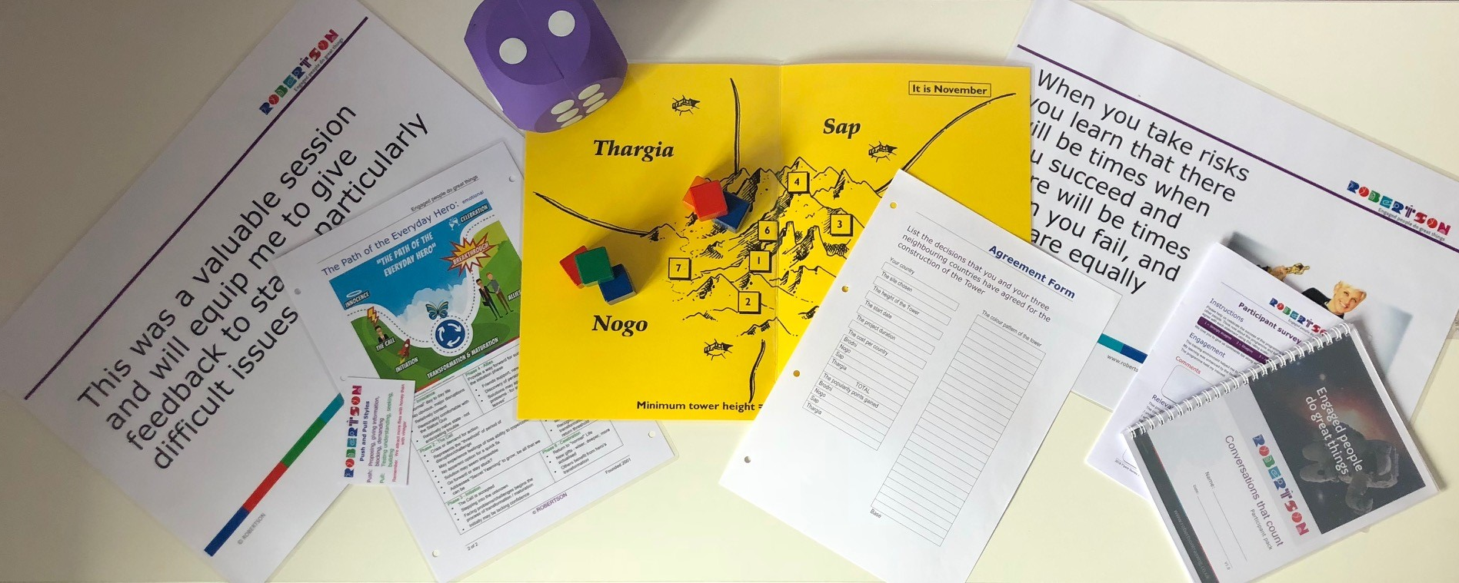
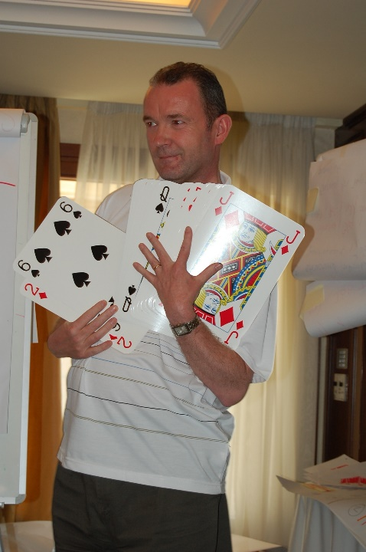
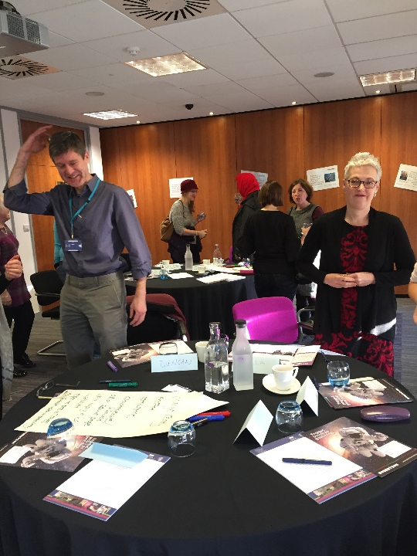
Learning is created not consumed
Business skills, leadership and management development, team development and more

Slide 12
www.robertsontraining.co.uk Tel: 01786 447 548 Email: Elaine@robertsontraining.co.uk
Business skills, leadership and management development, team development and more

